Slide 1

Presentation on National Payment System in Kenya
Michael Eganza, Director Banking and Payment Systems, Central Bank of Kenya

Slide 2
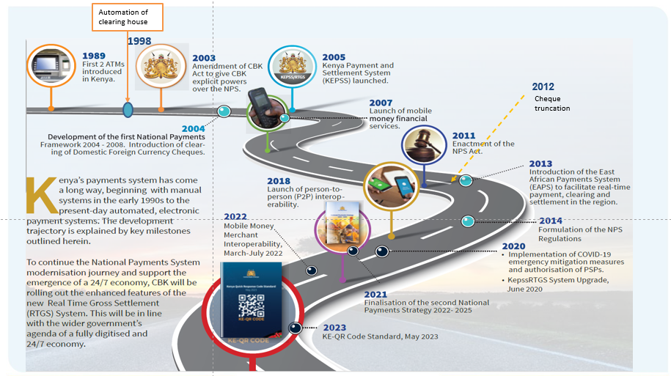
1.
National Payment System Evolution

Slide 3
The National Payments System Landscape in Kenya
2.
Has two components: Large value and Retail payments
E-money Issuers
Large Value Payment Systems
Typically handle large-value and high-priority/time critical payments
Retail Payment Systems
Typically handle a large volume of relatively low-value payments
KEPSS
E-Wallet Provider
EAPS
Switches
REPSS
ACH
*CSD
Payment Gateway/
KEPSS - Kenya Electronic Payment and Settlement System
EAPS - East African Payment System
REPSS - Regional Electronic Payment Settlement System
ACH - Automated Clearing House
Aggregators are also called Payment Gateways

Slide 4
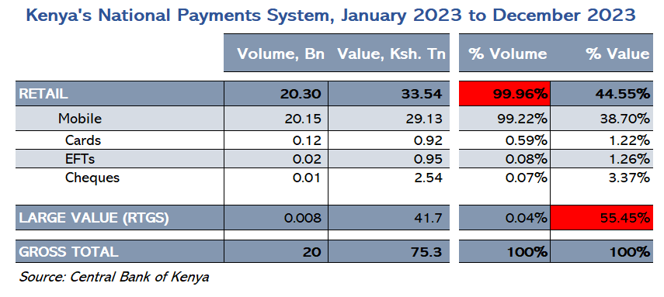
3.
Performance of National Payment System

Slide 5
Government Payments and Remittances
4.
Ksh.3.40 Tn
U.S.$4.19 Bn
Gov’t Payments at CBK, 2023
(Source: Central Bank of Kenya)
Diaspora receipts, 2023
(Source: Diaspora Survey, Central Bank of Kenya)

Slide 6
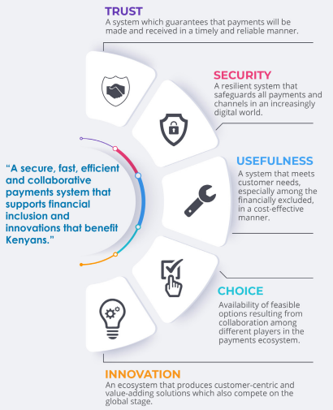


5.
National Payments Strategy 2022 - 2025

Slide 7
6.
What we have done well (1)
Financial inclusion has been entirely driven by mobile payments

Slide 8
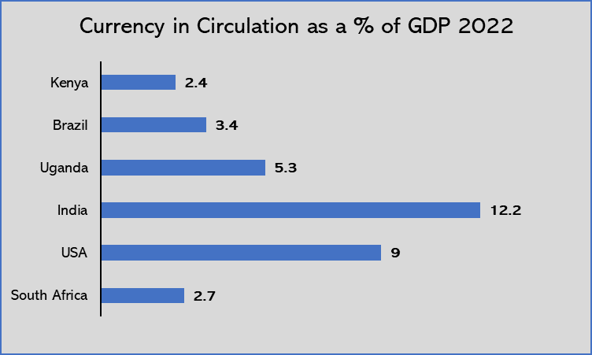
7.
What we have done well (2)
Measure of the extent of how, Kenyan economy is digitized
1.8 % is currency in circulation outside Banks
Source: IMF statistics.

Slide 9
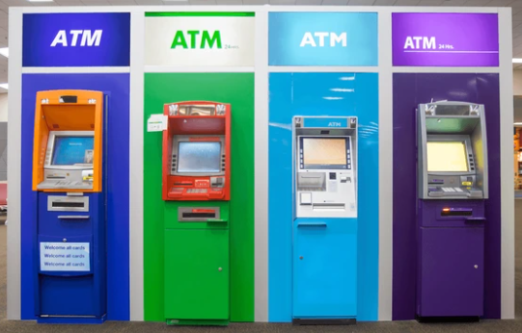

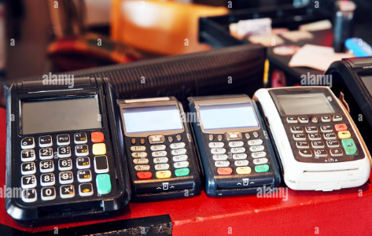
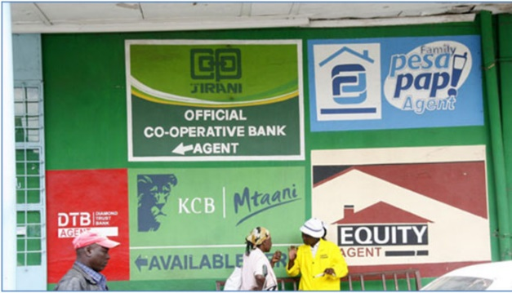
8.
Challenges (1) – what we are addressing
Limited infrastructure sharing
Inefficient utilization of physical infrastructure (ATMs and POS devices)
Multiple/closed systems telco, banks, non-banks
Multiple banks ATMs
Outlet recruited by different players
Cashier counter displaying several POS
Lack of sharing infrastructure by agents

Slide 10




9.
Challenges (2)
Limited functional interoperability
Bilateral agreements with costly bilateral connections.
Each bilateral arrangement requires a separate agreement, connectivity, prefunding
Bank/Wallet transfers
Bank/Wallet transfers
Bank/Wallet transfers
Bank/Wallet transfers
P2P
Merchant Interop

Slide 11

10.
Challenges (3)
High transaction costs to the end user
Persona A
Demographic
Occupation: Boda rider
Monthly Income: Kes 20,000
Age: 28 years
Location: Nairobi
Education: Secondary level
2.5% of monthly income is consumed on transaction charges which is a significant portion.

Slide 12
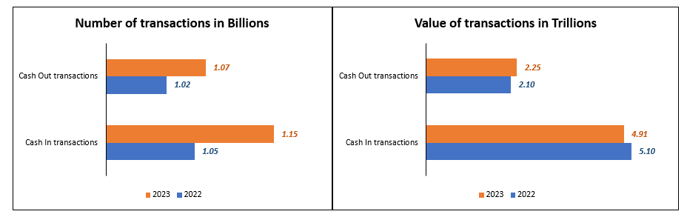
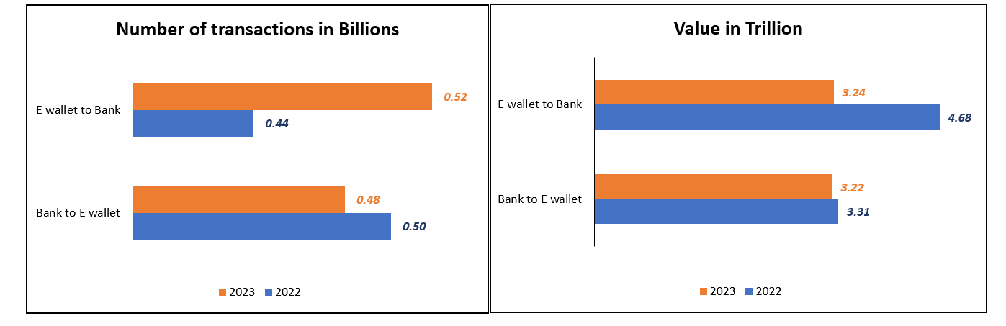
Challenges (4)
High levels of cashouts

Slide 13

11.
Challenge (5)
Astonishingly instant payments continue to trail slow rails and paper
Current Usage, 2023
 | Volume, Mn | Value, Ksh. Bn | Funds received
Cheques | 14 | 2,540 | T+1
EFT | 17 | 947 | T+1
Offnet Transactions (Mobile money) | 934 | 5,862 | Instant
Instant Payment System | 6 | 827 | Instant
KEPSS | 8 | 41,743 | 2 hours
Astonishingly instant payments continue to trail slow rails and paper. \There is a role to be played by regulator .

Slide 14
12.
Overall message and summary
High cost of low-value retail payments
Inefficiency, constrained oversight, stability challenges
Cumbersome customer experience, friction in off-net payment transactions
Exclusion – institutions that have to participate in NPS through PSPs or banks

Slide 15
Near-term priorities (selected)
Full-scale interoperability – Building on existing collaboration, progress ; “pay anyone anywhere”
Review the existing legal and regulatory framework
Continue exploring the usefulness of new forms of digital money (CBDC) and their use cases for Kenya
Regional and pan-African payments integration – Through harmonization of regulatory frameworks and infrastructure.
Progression towards 24/7 economy – Anchored on enhanced capabilities of the new RTGS system
Fostering customer-centric innovation – While assessing applicability (customer focus) and mitigating risks

Slide 16


